Slide 1
Year 9 ceramics
Examples for assessment task

Slide 2
Leaf shaped slab constructed pot

Slide 3
Mould constructed decorative pot

Slide 4
Coil pot with animal figure head

Slide 5
Elephant bookends

Slide 6
Coil constructed pot with decorative rim

Slide 7
Slab constructed bow with decorative handle and sides

Slide 8
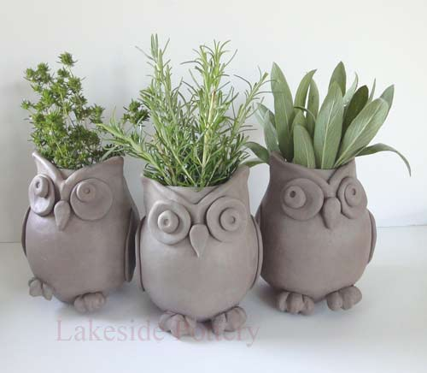
Clay animal planters

Slide 9
Decorative plant pot

Slide 10
Creature pots

Slide 11
Carved slab constructed pots

Slide 12
Slab constructed pots

Slide 13
Primitive face pots

Slide 14
Expressions face pots

Slide 15
Comical face jugs

Slide 16
Comic figure pots

Slide 17
Monster lolly jar

Slide 18
Elephant bowl

Slide 19
Hand pot

Slide 20
Hand pot too

Slide 21
Skull oil burner

Slide 22
Jungle pot with lid

Slide 23
Pinch pots

Slide 24
Moulded coil pot

Slide 25
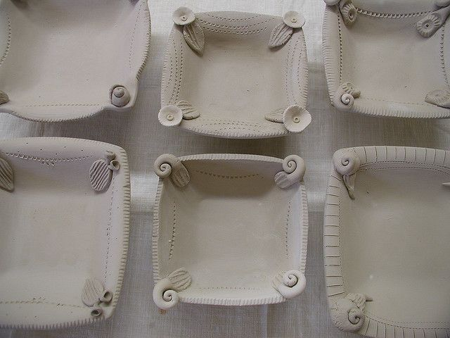
Trays

